Slide 1
2.4 Interprocess Communication

Slide 2
Cooperating Processes
+ Independent process cannot affect or be affected by the execution of another process
+ Cooperating process can affect or be affected by the execution of another process
+ Advantages of process cooperation :
Information sharing
Computation speed-up
Modularity
Convenience

Slide 3
Problem of shared data
1. Concurrent access to shared data may result in data inconsistency
2. Maintaining data consistency requires mechanisms to ensure the orderly execution of cooperating processes
3. Need of mechanism for processes to communicate and to synchronize their actions

Slide 4
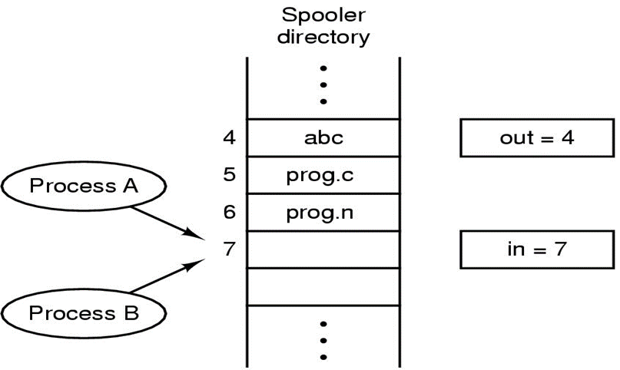
Race Conditions
+ Two processes want to access shared memory at same time and the final result depends who runs precisely, are called race condition
+ Mutual exclusion is the way to prohibit more than one process from accessing to shared data at the same time

Slide 5
Critical Regions
+ The Part of the program where the shared memory is accessed is called Critical Regions (Critical Section)
+ Four conditions to provide mutual exclusion :
1. No two processes simultaneously in critical region
2. No assumptions made about speeds or numbers of CPUs
3.No process running outside its critical region may block another process
4.No process must wait forever to enter its critical region

Slide 6
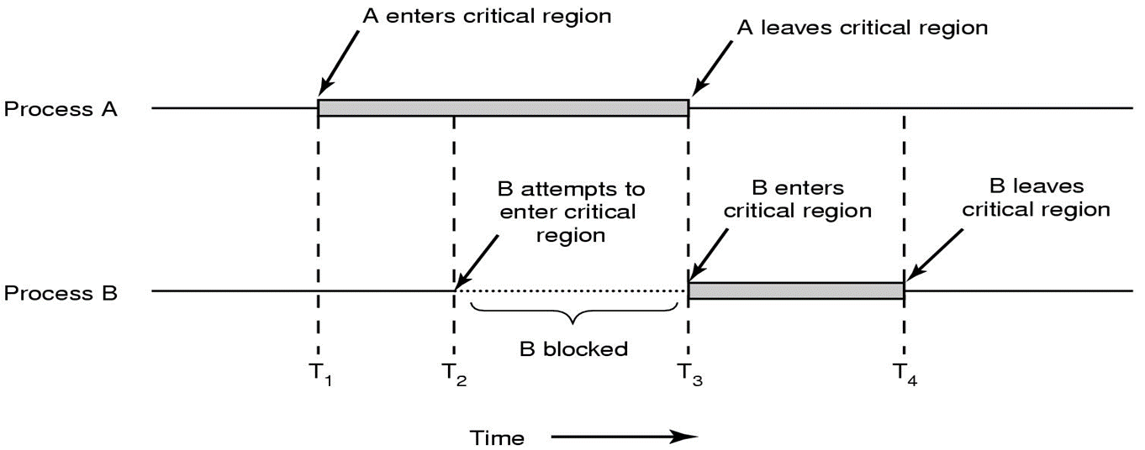
Mutual exclusion using critical regions (Example)
+ T1, A enters the critical area
+ After a while, T2 , B want to enter the critical area, but have to wait
+T3, A goes out of critical region, B gets into critical region

Slide 7

Solution: Mutual exclusion with Busy waiting
◦ Software proposal
+ Lock Variables
+ Strict Alternation
+ Peterson's Solution
◦ Hardware proposal
+ Disabling Interrupts
+ The TSL Instruction

Slide 8
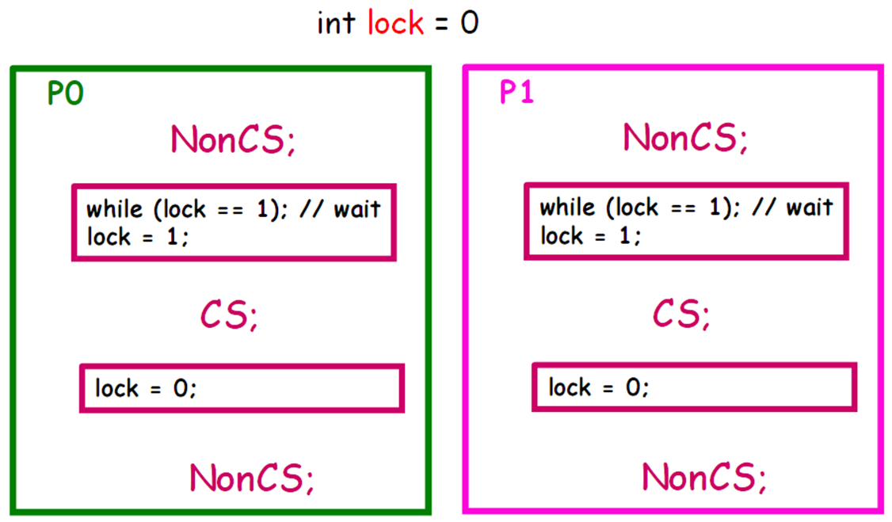
Software Proposal 1: Lock Variables
+ Lock = 0, no process is in its critical region
+ Lock = 1, some process is in its critical zone

Slide 9
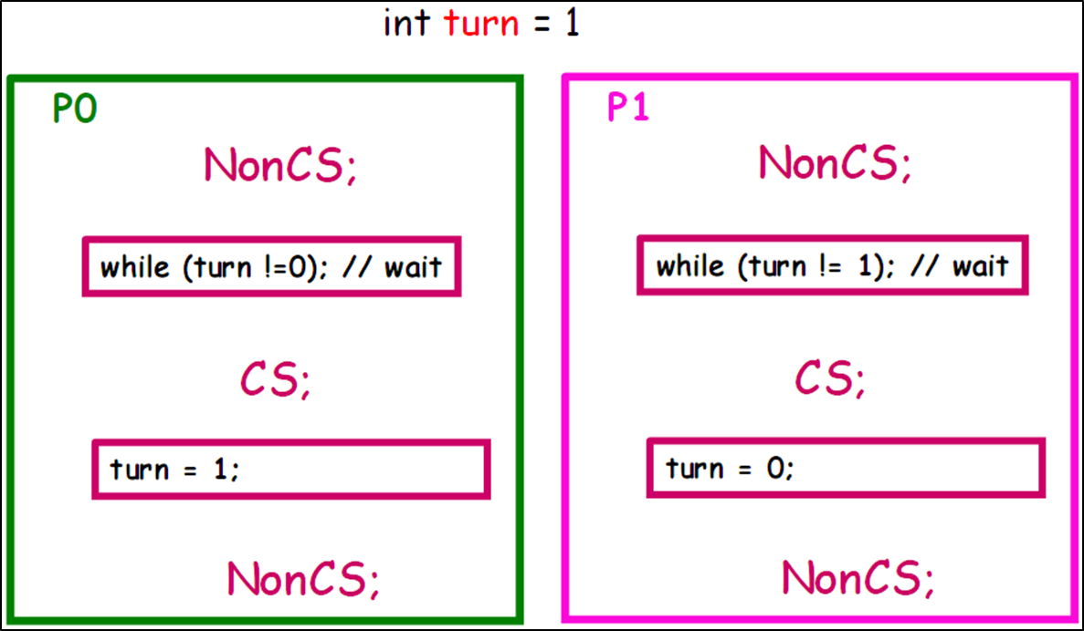
Software Proposal 2: Strict Alternation
+Turn = 0,
+P0 enters the critical region, P1 enters a continuous loop
+P0 leaves critical region, Turn = 1, P1 enters critical region

Slide 10
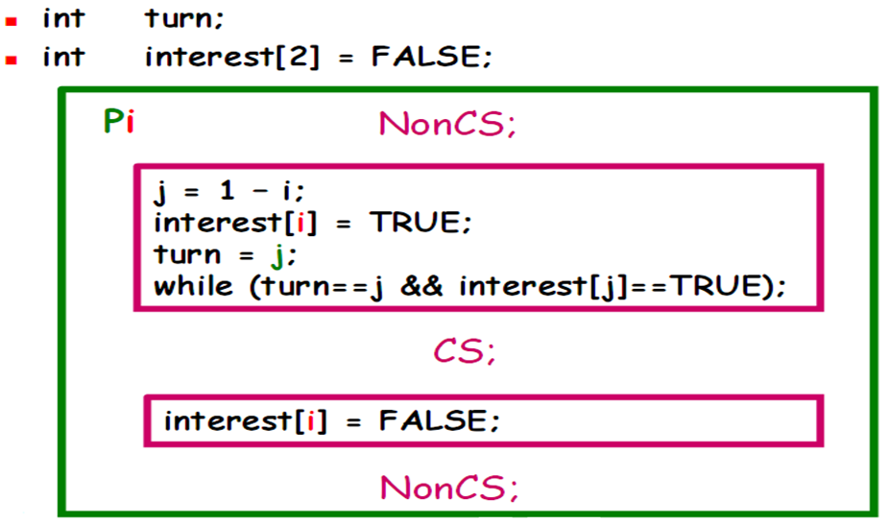
Software Proposal 3: Peterson's Solution
○ Satisfy 3 conditions:
+ Mutual Exclusion
Pi can enter CS when interes[j] == F, or turn == i
If both want to come back, because turn can only receive value 0 or 1, so one process enter CS
+ Progress
Using 2 variables distinct interest[i] ==> opposing cannot lock
+ Bounded Wait: both interest[i] and turn change value
○ Not extend into N processes
+ Pi sets interest[i] = TRUE, turn = j
+ If Pj does not enter the critical region (interest[j] = FALSE), then Pi can enter the critical region
+ When Pi leaves the critical region it resets to interest[i] = FALSE

Slide 11
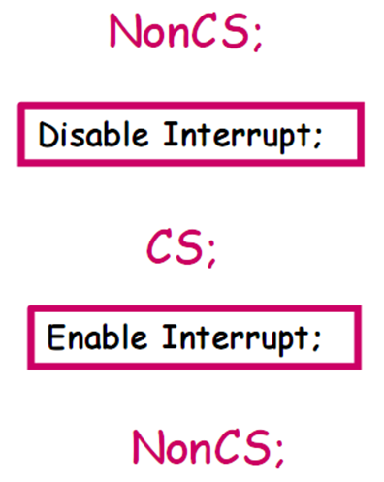
Hardware Proposal 1: Disabling Interrupt
Not be careful
+ If process is locked in CS?
System Halt
+ Permit process use command privileges
Danger!
System with N CPUs?
Don't ensure Mutual Exclusion
+ A process is allowed to disable interrupts before entering its critical region
+ Then enable interrupts when leaving the critical region

Slide 12
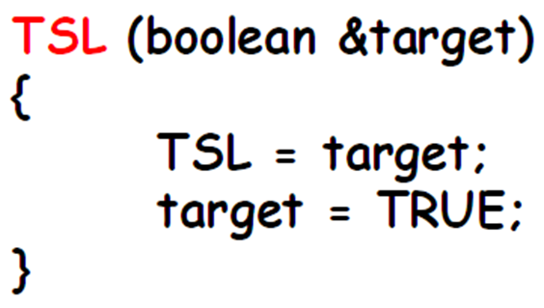
Hardware proposal 2: TSL Instruction
CPU support primitive Test and Set Lock
+ Return a variable's current value, set variable to true value
+ Cannot divide up to perform (Atomic)

Slide 13
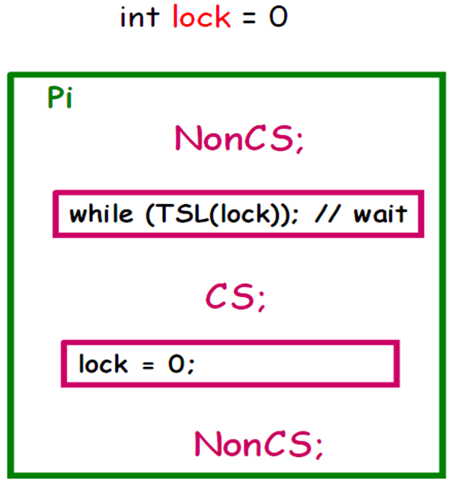
Applied TSL
+ Lock = 0, any process can set Lock to 1 using the TSL directive and then enter the critical area.
+ When exit, reset set lock = 0

Slide 14
Comment for hardware solutions in Busy-Waiting
○ Necessary hardware mechanism's support
Not easy with n-CPUs system
○ Easily extend to N processes
○ Using CPU not effectively
Constantly test condition when wait for coming in CS
○ Overcome
Lock processes that not enough condition to come in CS, concede CPU to other process
Using Scheduler
Wait and See...

